Slide 1
Sample store Dashboard
Prepared by: T Sanjana(data analyst intern)
date: 16/5/2025

Slide 2
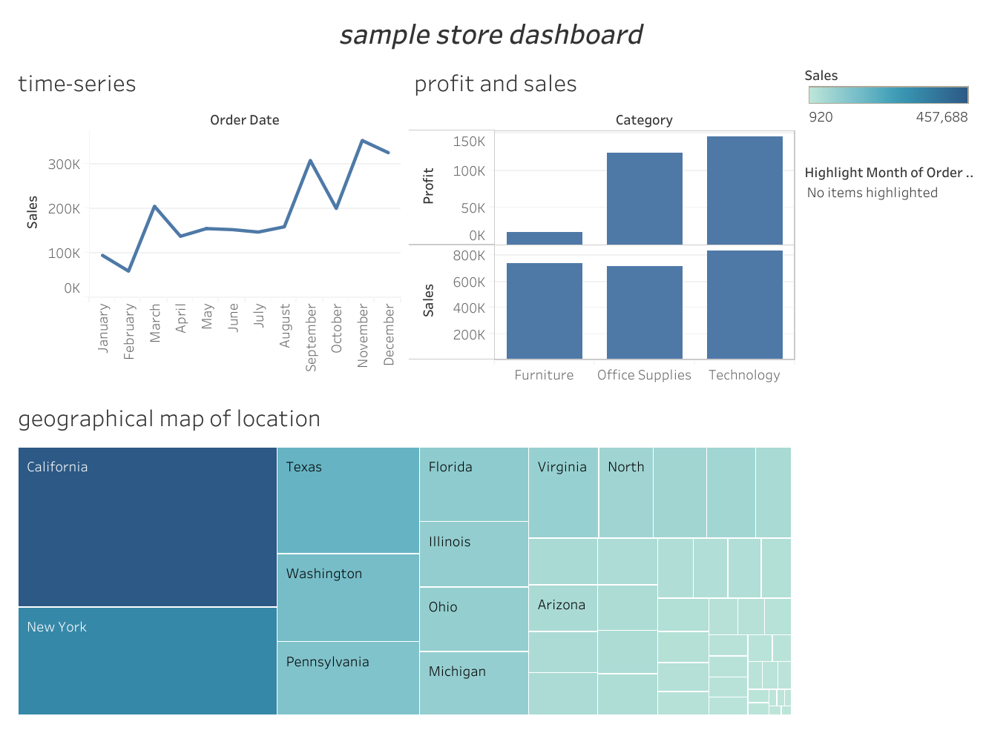

Slide 3
Technical implementation
Tools used:
Tableau
Dataset used:
superstore sales dataset(from Kaggle)

Slide 4
Dashboard features
Time series line chart :- to show sales trends over months
Geographic performance map :- to show sales distribution across key states
Category breakdown :- profit vs. sales comparisions
Performance Summary Cards :- Total sales tracking (~$457K)

Slide 5
Notable findings
Seasonal Patterns: Visible fluctuations in profit across months
Regional Performance: California and New York as top markets
Category Analysis: Technology shows strongest profit margins
Total Performance: $457,688 in tracked sales

Slide 6
Recommendations & Next Steps
Actionable Insights:
1. Focus marketing efforts on high-performing regions (CA/NY)
2. Investigate seasonal profit dips for mitigation strategies
3. Expand technology product offerings
Future Enhancements:
Add customer segmentation analysis
Incorporate inventory turnover metrics
Develop predictive forecasting models

Slide 7
THANK YOU

